Slide 1

VPH-Share Tutorial
Portal Login & Access
Workflow Development & Orchestration

Slide 2



VPH-Share Research Platform
VPH-Share is a 20-Partner FP7 Integrated Project that is constructing an online, cloud-based environment in which users can share software tools, applications and data, and can develop and execute in silico clinical workflows.
Four Flagship Workflows are included as demonstrators and, in recent months a significant number of additional Use Cases have been added to the project, several of which are already active
Operational for over 12 months, with new features and content being added continuously.

Slide 3




Platform Building Blocks
Unified Identity
Security
Workflows
Semantics
High Performance
Applications
Structured Data
Cloud Computing
Unstructured data

Slide 4


VPH-Share - Research Partnerships
Academic Partners
Industrial Partners
Clinical Partners
Third-Party Collaborators
Notes:
Slide Objectives:
Describe our current mix of partners and collaborators
Speaking Points:

Slide 5
Reviewers: Guided Introduction
At the project’s second periodic review in April 2013 the Reviewers proposed that, to obtain an enriched appreciation of the system, they might have access to the infrastructure during the two week period prior to the 3rd Periodic Review. This has been arranged, and VPH-Share accounts have been enabled for each reviewer.
VPH-Share, although carefully designed, is none-the-less a complex infrastructure and, as with all such systems, the full benefits emerge after a degree of familiarisation.
To help with this learning process we have prepared a set of illustrated guidance slide-sets that show users how to begin using the system and carry out three common activities.

Slide 6
For the busy reviewer
In all cases you’ll need to see through the Login process. The three activities are then described in separate tutorials, and each requires around 40 minutes to complete. If time doesn’t permit this degree of engagement, it may be that an agreement between Reviewers to split the three tasks amongst you may be a possible solution.
If this is palatable, the data-centred activities are probably the least challenging (perhaps 4/10), with the application and workflow development activities being the most challenging (perhaps 7/10)
If you’re particularly time-challenged, but would still like to try the system, the Data activity includes as its final step a search exercise to identify semantically-tagged data; this will give a flavour of the system without requiring a large investment of time.

Slide 7
Workflow Orchestration
Workflow Development and Execution

Slide 8
Summary
The ultimate goal of many VPH-Share users is to employ the Infrastructure to develop complete workflows capable of accepting patient data as inputs and presenting clinically-relevant diagnostic or treatment information as outputs. These workflows are typically assembled from pre-existing Applications that are chained together to interact and provide clinical solutions. This Workflow guide covers the creation of such a workflow:
We start with an incomplete workflow that will be finished by the addition of missing facilities
The incomplete workflow is opened in the online workflow editor ‘Taverna Online’, which gives a diagrammatic view of the existing components and their interconnections
A new service is added, its parameters are entered, and it is connected into the existing workflow
The resulting workflow is saved with a new name
We execute the new workflow, providing details of the required source data
We inspect various details of the running workflow ‘instance’
Finally we share the completed and tested workflow with other users

Slide 9
Workflow Execution
01
Search & Discovery
04
Workflow Execution
02
Workflow Development
05
Sharing & Permissions
03
Taverna Online

Slide 10
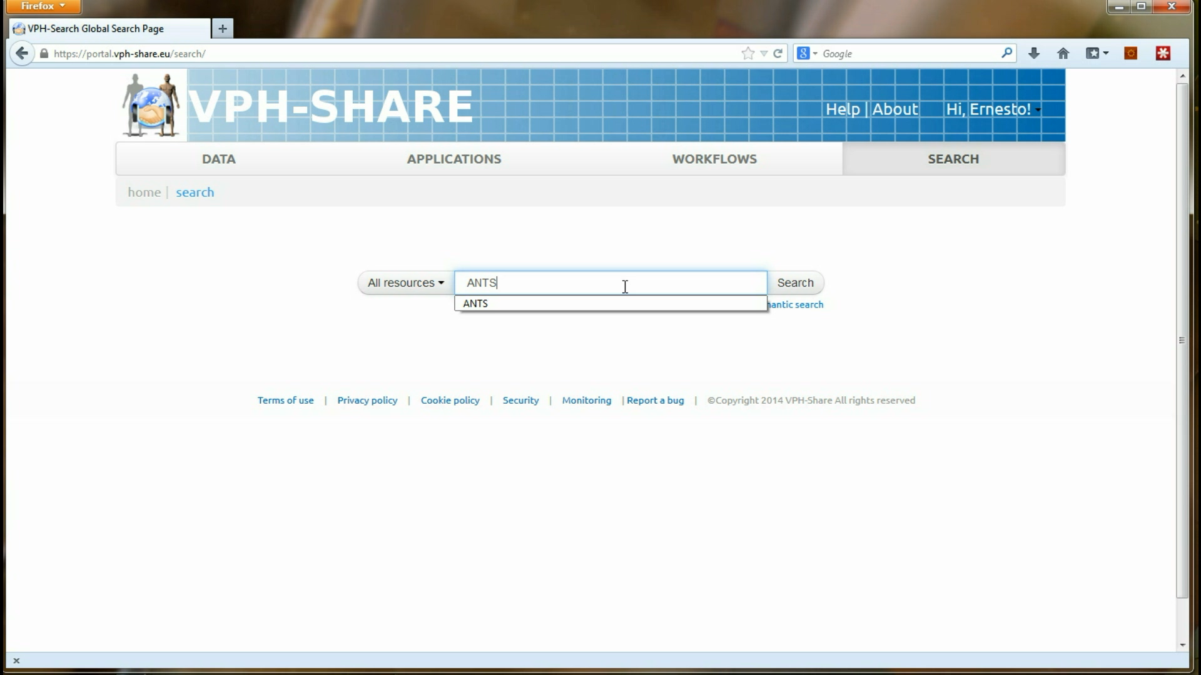
Video - Workflow Editing & Execution

Slide 11
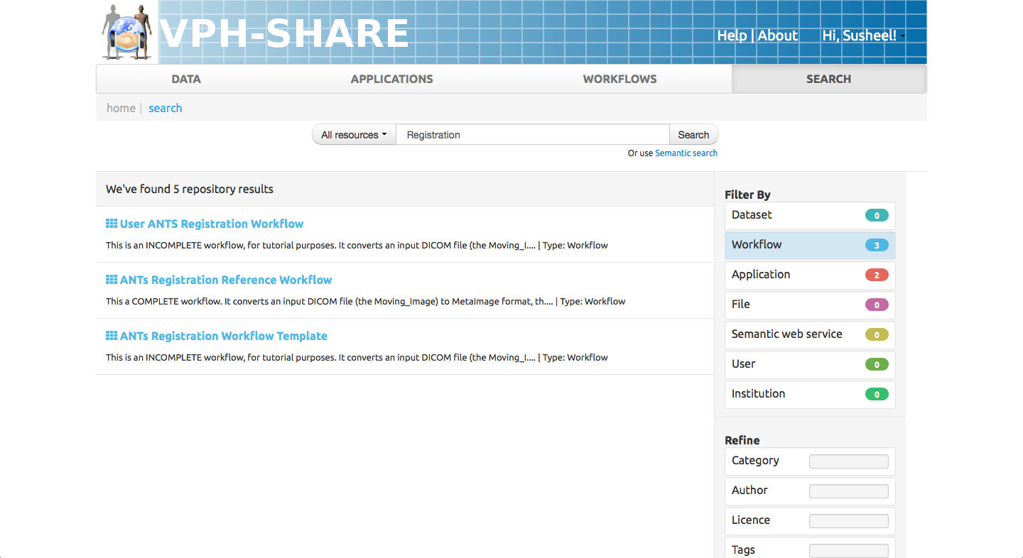
01
Search & Discovery
Click Search > Type ‘Registration’ > Facet ‘Workflow’
Click on ‘ANTs Registration Workflow Template’
b
VPH-Share provides pre-configured and template scientific workflows which are annotated with semantic concepts and and may use internal and external services
Notes:
User Manual: http://www.vph-share.eu/content/browse-and-search-workflows

Slide 12
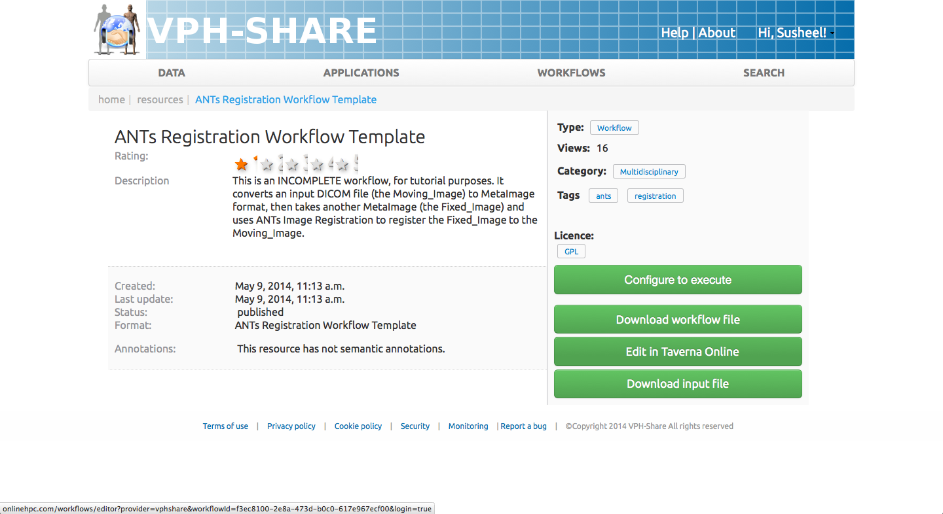
01
Search & Discovery
Click Search > Type ‘Registration’ > Facet ‘Workflow’
Click on ‘ANTs Registration Workflow’
View metadata and click ‘Edit Taverna Online’
c
VPH-Share has collaborated with OnlineHPC to provide web-based workflow editing capabilities to users.
Notes:
User Manual: http://www.vph-share.eu/content/browse-and-search-workflows

Slide 13
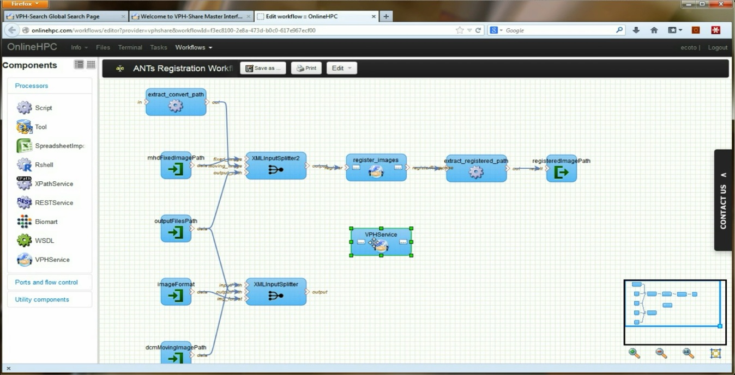
02
Workflow Development
Drag & Drop ‘VPHService’ onto workflow
a
VPH-Share via Taverna Online allows users to import services, workflows and data into their Taverna Online workspace for development and execution.
Notes:
User manual: http://www.vph-share.eu/content/workflow-composition-taverna-online

Slide 14
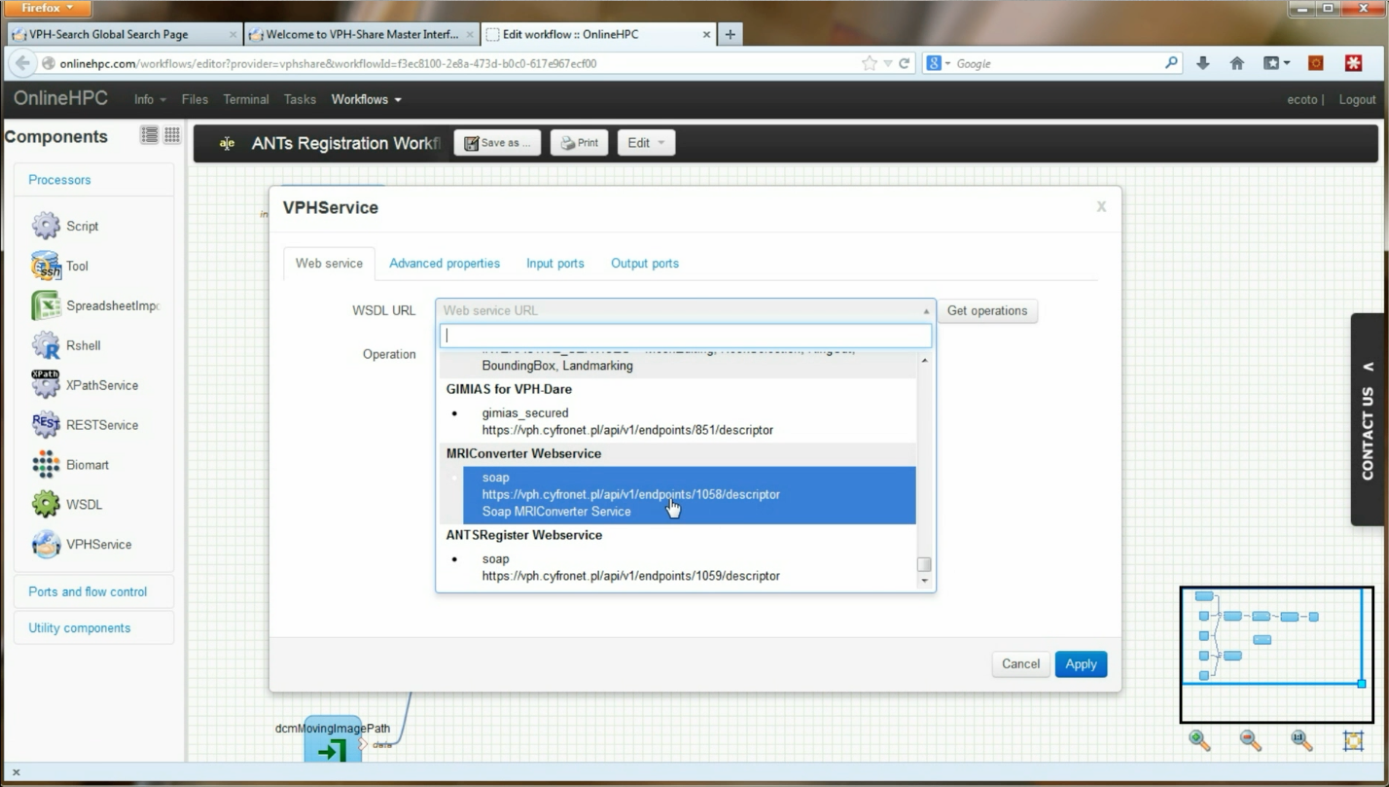
02
Workflow Development
Drag & Drop ‘VPHService’ onto workflow
Double-click VPHService to configure the service
Choose MRIConverter Webservice and get operations
Choose convert and click Apply
c
VPH-Share via Taverna Online allows users to import services, workflows and data into their Taverna Online workspace for development and execution.
Notes:
User manual: http://www.vph-share.eu/content/workflow-composition-taverna-online

Slide 15
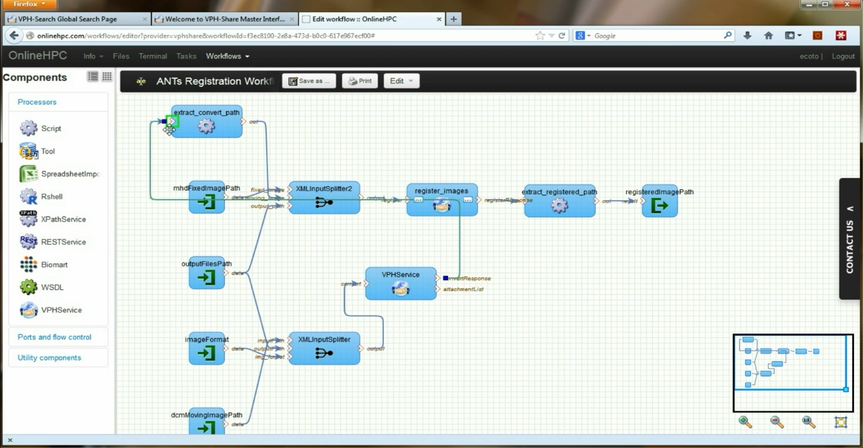
02
Workflow Development
Connect XMLInputSplitter to the VPHService convert
Connect VPHService convertResponse to extract_convert_path
f
e
VPH-Share via Taverna Online allows users to import services, workflows and data into their Taverna Online workspace for development and execution.
Notes:
User manual: http://www.vph-share.eu/content/workflow-composition-taverna-online

Slide 16
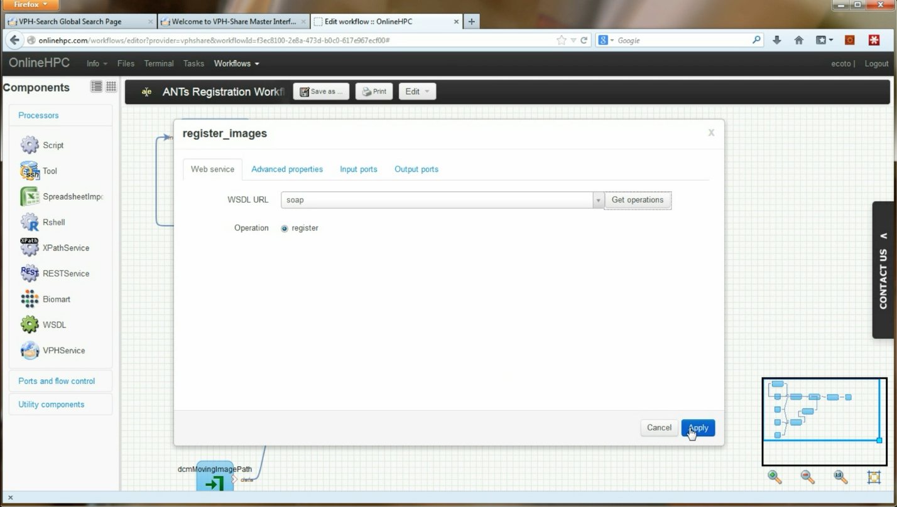
02
Workflow Development
Connect XMLInputSplitter to the VPHService convert
Connect VPHService convertResponse to extract_convert_path
Double-click register_images and get operations and select register and Apply
g
VPH-Share via Taverna Online allows users to import services, workflows and data into their Taverna Online workspace for development and execution.
Notes:
User manual: http://www.vph-share.eu/content/workflow-composition-taverna-online

Slide 17
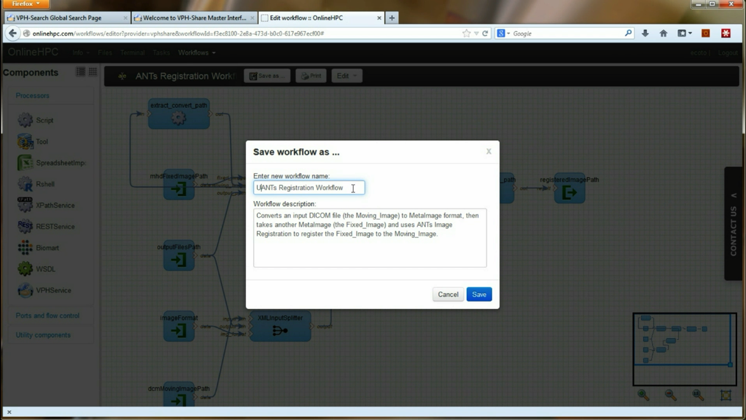
03
Taverna Online
Click Save as
Rename workflow as “NAME ANTs Registration Workflow” and click Save
Click Launch
a
b
VPH-Share provides complete integration with Taverna Online as user are able to save and execute their workflows back to VPH-Share
Notes:
User manual: http://www.vph-share.eu/content/workflow-composition-taverna-online

Slide 18
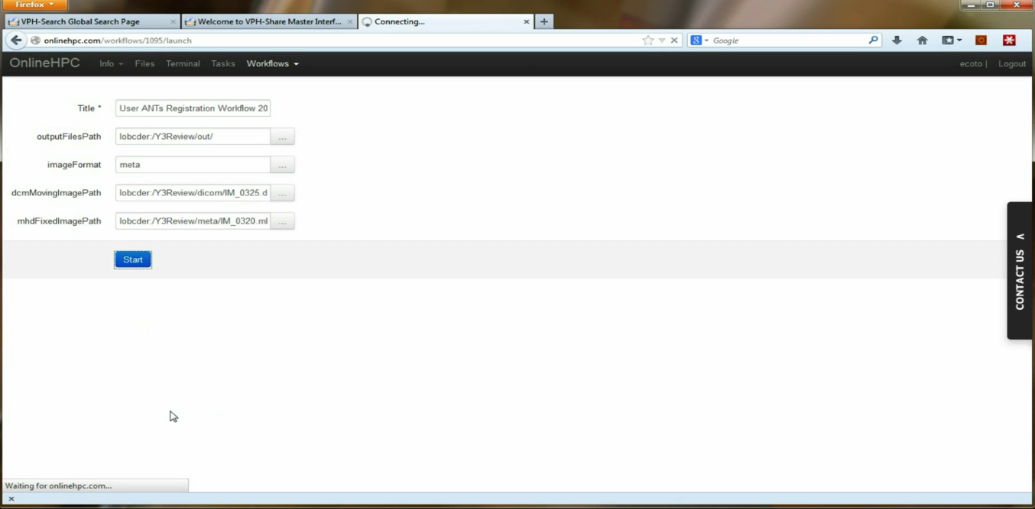
03
Taverna Online
Fill input parameters with:
outputFilesPath: Pick home > NAME > demo > out
imageFormat: meta
dcmMovingImagePath: Pick home > NAME > demo > dicom > IM_0325.dcm
dcmFixedImagePath: Pick home > NAME > demo > dicom > IM_0320.dcm
Click Start
d
e
Users are able to configure their workflows with parameters and by selecting input files form VPH-Share
Notes:
User manual: http://www.vph-share.eu/content/workflow-execution-taverna-online

Slide 19
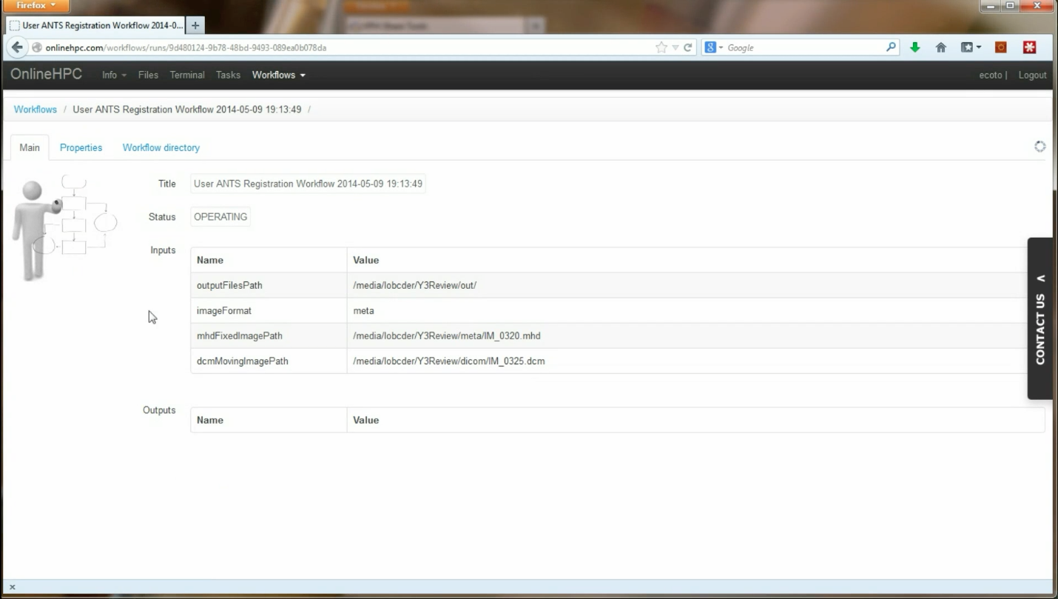
03
Taverna Online
Click on Properties to view the workflow properties
Click on Workflow directory to view
f
g
Workflows can also be executed from within Taverna Online
Notes:
User manual: http://www.vph-share.eu/content/workflow-execution-taverna-online

Slide 20
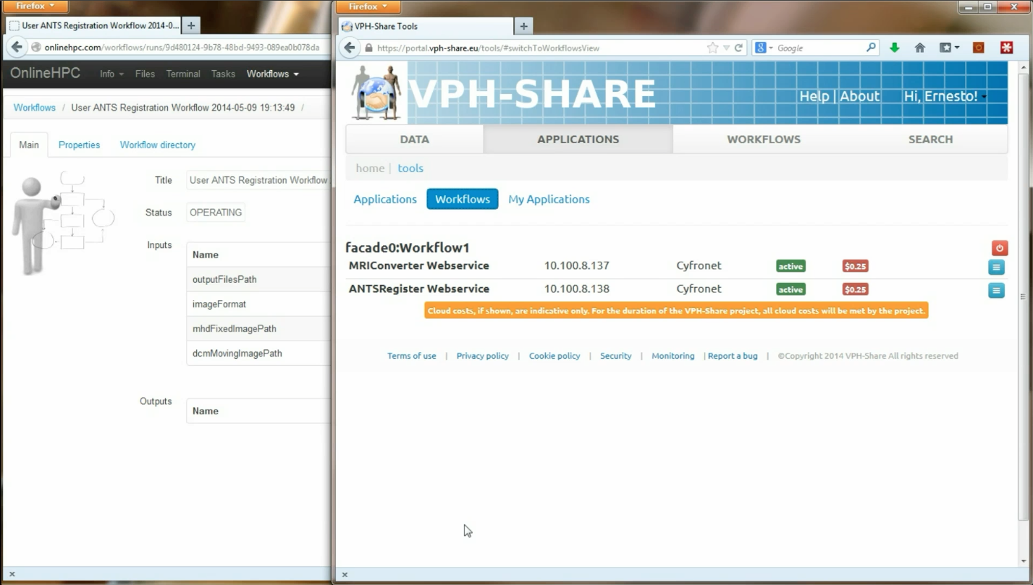
04
Workflow
Execution
Navigate to Applications > Workflows
View Applications automatically started by the the workflow. MRIConverter and ANTSRegister
b
Taverna Online executed workflows automatically starts Applications within VPH-Share for processing by the workflow
Notes:
User manual: http://www.vph-share.eu/content/workflow-execution-taverna-online

Slide 21
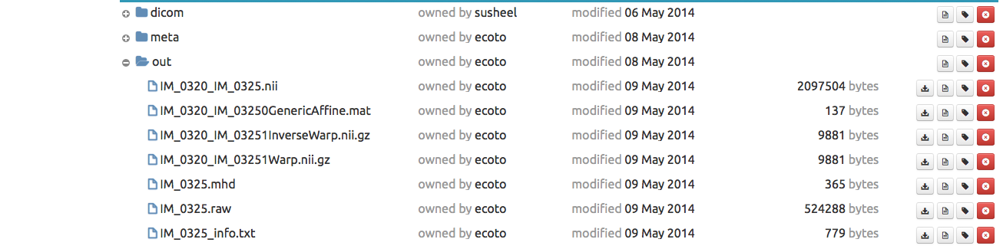
04
Workflow
Execution
Navigate to Applications > Workflows
View Applications automatically started by the the workflow. MRIConverter and ANTSRegister
On completion, navigate to FileStore and your home directory to view the converted files.
VPH-Share allows
Notes:
User manual: http://www.vph-share.eu/content/workflow-execution-taverna-online

Slide 22
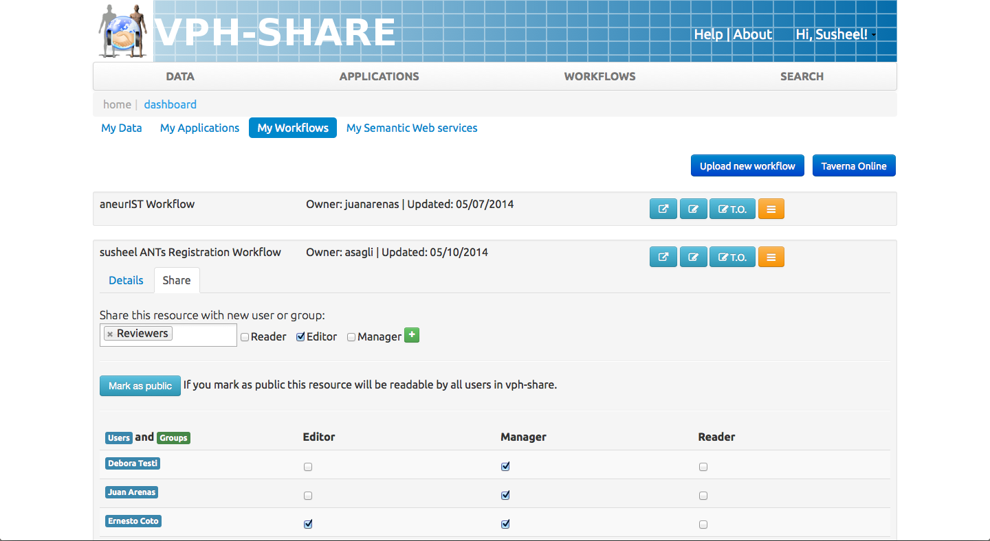
05
Sharing
& Permissions
Click on your NAME > Dashboard > My Workflows
Select your Application > > Share Tab
Search for individual or Group
Choose permission ‘Editor’ and click the plus sign
a
b
c
d
VPH-Share allows fine-grained permissions on all resources. Sharing may be performed on individuals and/or groups according to the needs of the resource
Notes:
User manual: http://www.vph-share.eu/content/grant-permissions

Slide 23
GLOSSARY
API – Application Programming Interface
Workflow – A sequence of steps configured to be performed by passing data or control signals

Slide 24
Notes:
Slide Objectives:
Speaking Points:

Slide 25
Notes:
Slide Objectives:
Speaking Points:

